Slide 1
Chapter 13: I/O Systems
I/O Hardware
Application I/O Interface
Kernel I/O Subsystem
Transforming I/O Requests to Hardware Operations
Streams
Performance

Slide 2
I/O Hardware
Incredible variety of I/O devices
Common concepts
  Port
  Bus (daisy chain or shared direct access)
  Controller (host adapter)
I/O instructions control devices
Devices have addresses, used by
  Direct I/O instructions
  Memory-mapped I/O

Slide 3
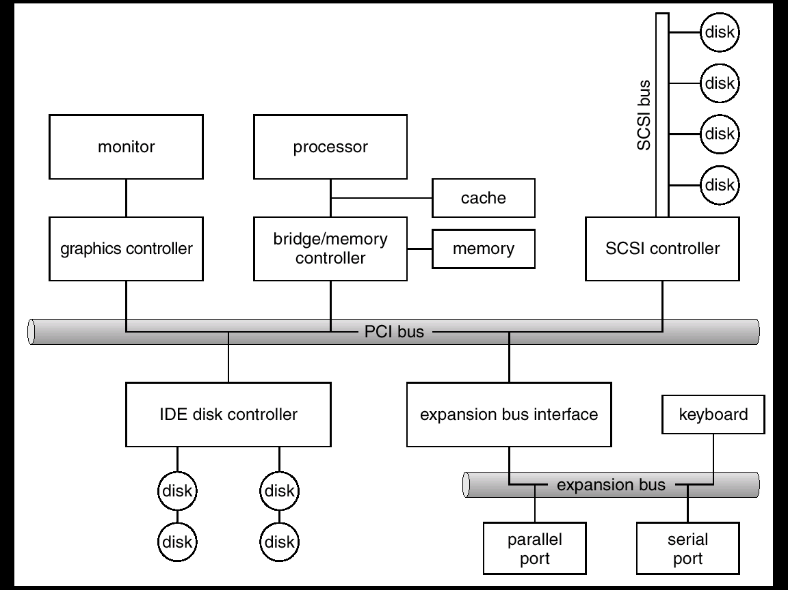
A Typical PC Bus Structure

Slide 4
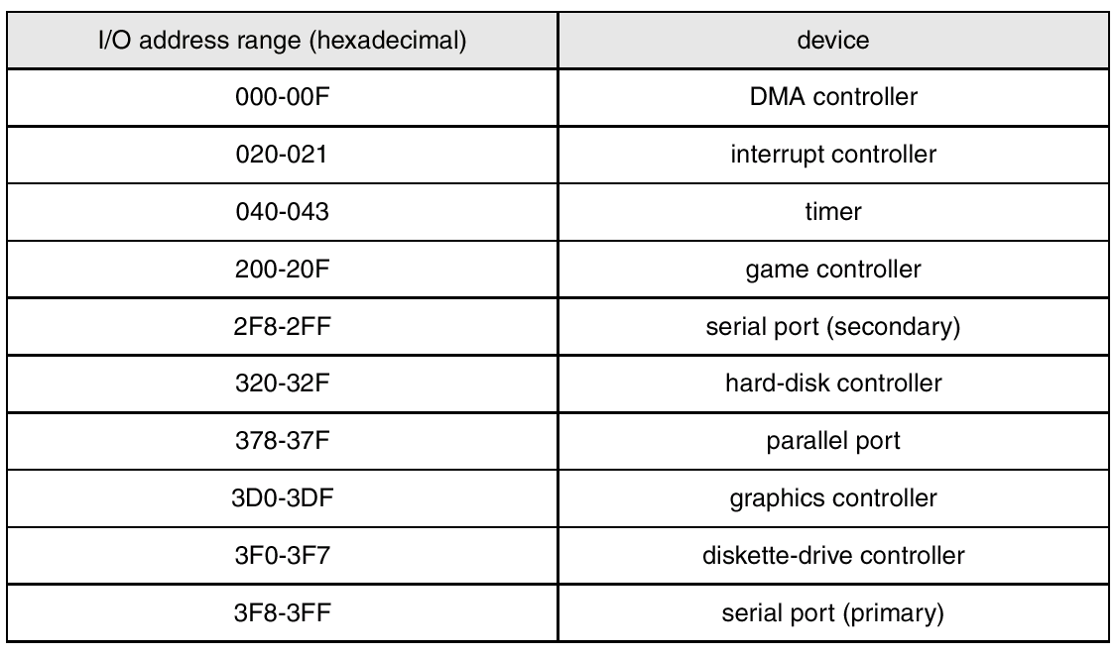
Device I/O Port Locations on PCs (partial)

Slide 5
Polling
Determines state of device
  command-ready
  busy
  Error
Busy-wait cycle to wait for I/O from device

Slide 6
Interrupts
CPU Interrupt request line triggered by I/O device
Interrupt handler receives interrupts
Maskable to ignore or delay some interrupts
Interrupt vector to dispatch interrupt to correct handler
  Based on priority
  Some unmaskable
Interrupt mechanism also used for exceptions

Slide 7
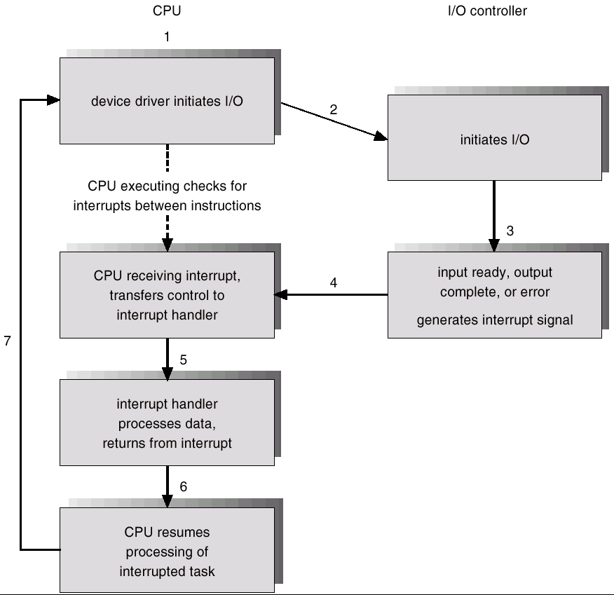
Interrupt-Driven I/O Cycle

Slide 8
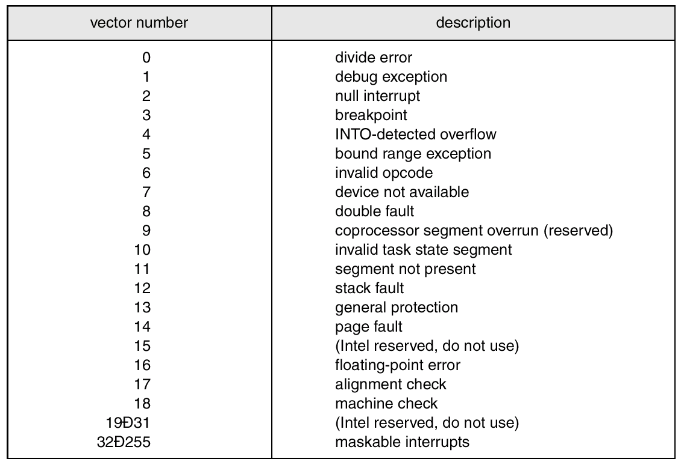
Intel Pentium Processor Event-Vector Table

Slide 9
Direct Memory Access
Used to avoid programmed I/O for large data movement
Requires DMA controller
Bypasses CPU to transfer data directly between I/O device and memory

Slide 10
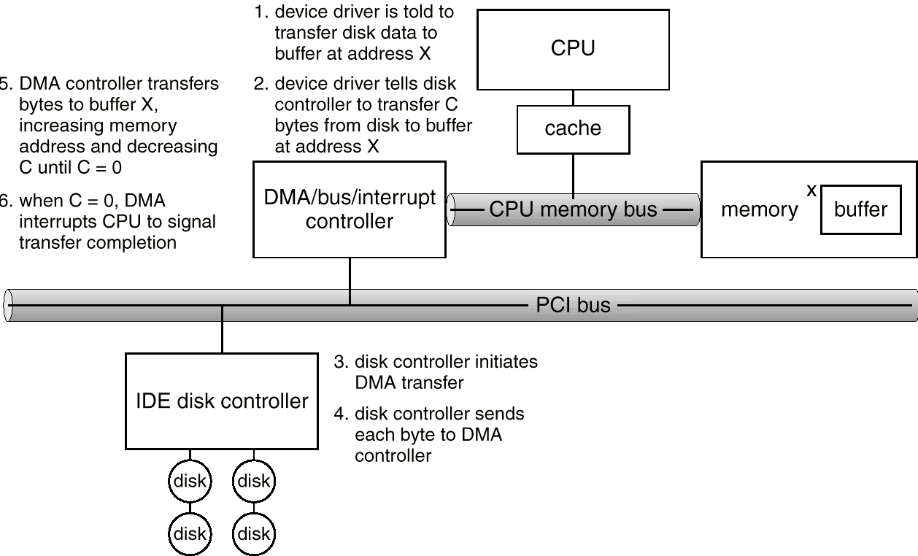
Six Step Process to Perform DMA Transfer

Slide 11
Application I/O Interface
I/O system calls encapsulate device behaviors in generic classes
Device-driver layer hides differences among I/O controllers from kernel
Devices vary in many dimensions
  Character-stream or block
  Sequential or random-access
  Sharable or dedicated
  Speed of operation
  read-write, read only, or write only

Slide 12
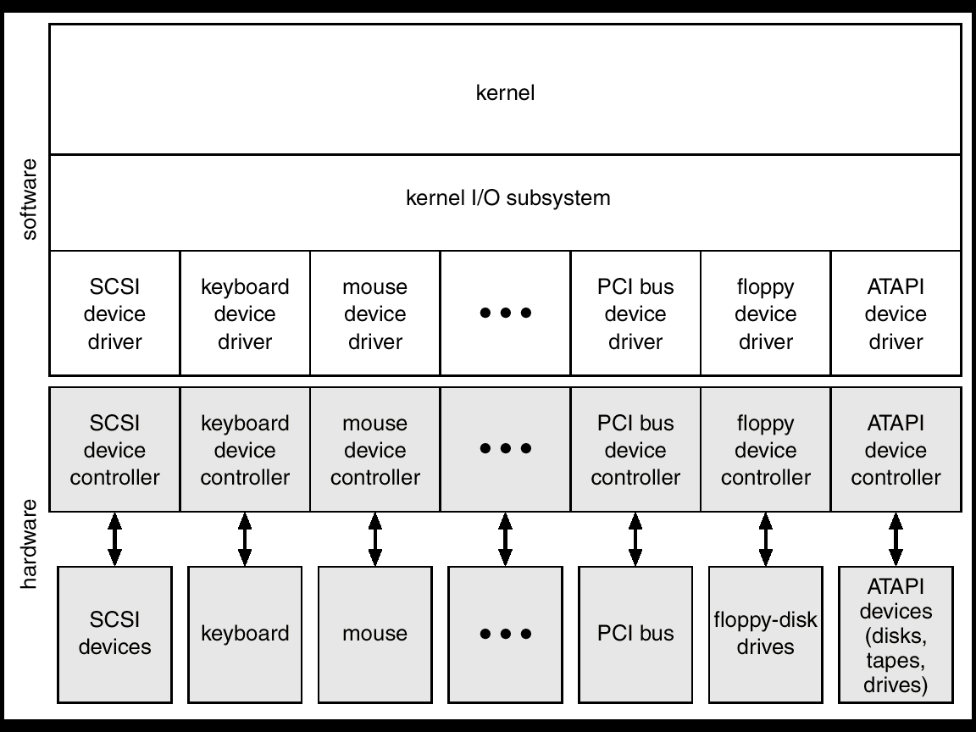
A Kernel I/O Structure

Slide 13
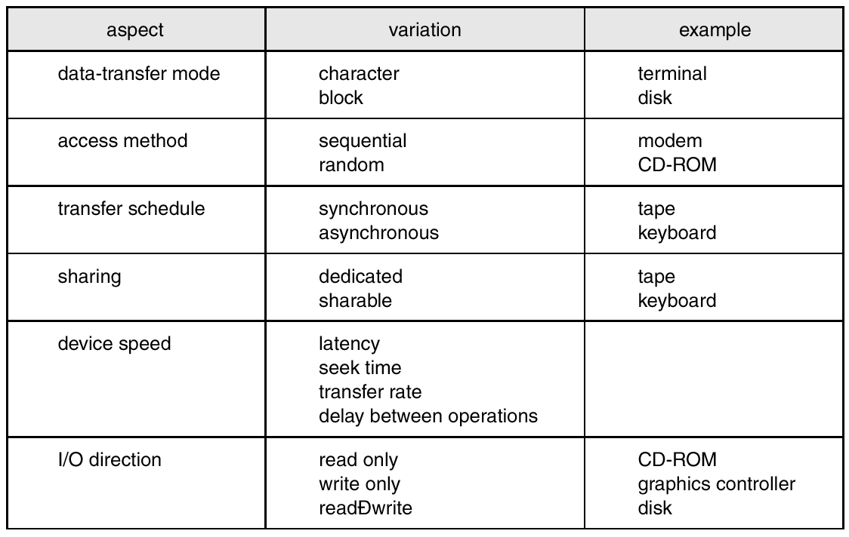
Characteristics of I/O Devices

Slide 14
Block and Character Devices
Block devices include disk drives
  Commands include read, write, seek
  Raw I/O or file-system access
  Memory-mapped file access possible
Character devices include keyboards, mice, serial ports
  Commands include get, put
  Libraries layered on top allow line editing

Slide 15
Network Devices
Varying enough from block and character to have own interface
Unix and Windows NT/9i/2000 include socket interface
  Separates network protocol from network operation
  Includes select functionality
Approaches vary widely (pipes, FIFOs, streams, queues, mailboxes)

Slide 16
Clocks and Timers
Provide current time, elapsed time, timer
If programmable interval time used for timings, periodic interrupts
ioctl (on UNIX) covers odd aspects of I/O such as clocks and timers

Slide 17
Blocking and Nonblocking I/O
Blocking - process suspended until I/O completed
  Easy to use and understand
  Insufficient for some needs
Nonblocking - I/O call returns as much as available
  User interface, data copy (buffered I/O)
  Implemented via multi-threading
  Returns quickly with count of bytes read or written
Asynchronous - process runs while I/O executes
  Difficult to use
  I/O subsystem signals process when I/O completed

Slide 18
Kernel I/O Subsystem
Scheduling
  Some I/O request ordering via per-device queue
  Some OSs try fairness
Buffering - store data in memory while transferring between devices
  To cope with device speed mismatch
  To cope with device transfer size mismatch
  To maintain “copy semantics”

Slide 19
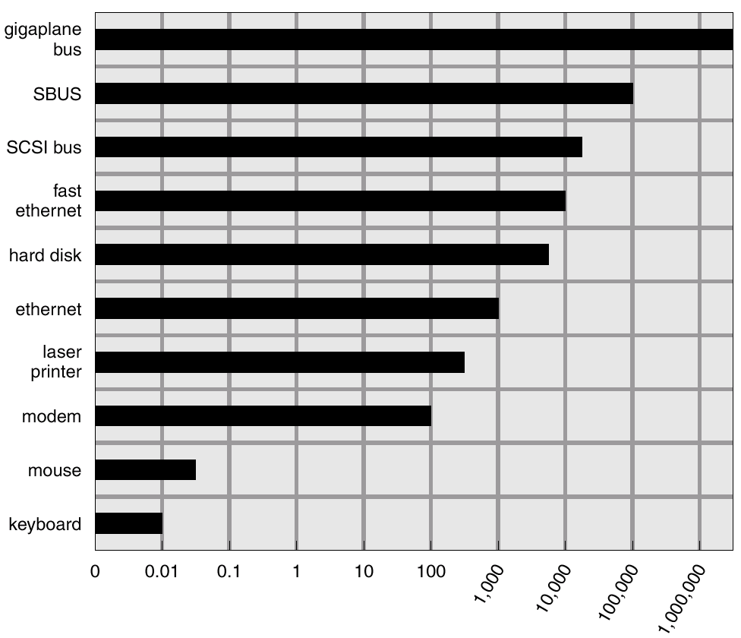
Sun Enterprise 6000 Device-Transfer Rates

Slide 20
Kernel I/O Subsystem
Caching - fast memory holding copy of data
  Always just a copy
  Key to performance
Spooling - hold output for a device
  If device can serve only one request at a time
  i.e., Printing
Device reservation - provides exclusive access to a device
  System calls for allocation and deallocation
  Watch out for deadlock

Slide 21
Error Handling
OS can recover from disk read, device unavailable, transient write failures
Most return an error number or code when I/O request fails
System error logs hold problem reports

Slide 22
Kernel Data Structures
Kernel keeps state info for I/O components, including open file tables, network connections, character device state
Many, many complex data structures to track buffers, memory allocation, “dirty” blocks
Some use object-oriented methods and message passing to implement I/O

Slide 23
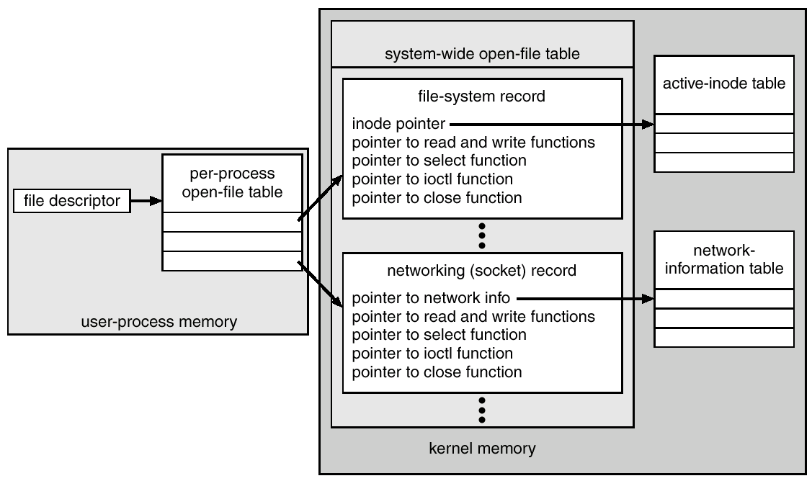
UNIX I/O Kernel Structure

Slide 24
I/O Requests to Hardware Operations
Consider reading a file from disk for a process:
  Determine device holding file
  Translate name to device representation
  Physically read data from disk into buffer
  Make data available to requesting process
  Return control to process

Slide 25
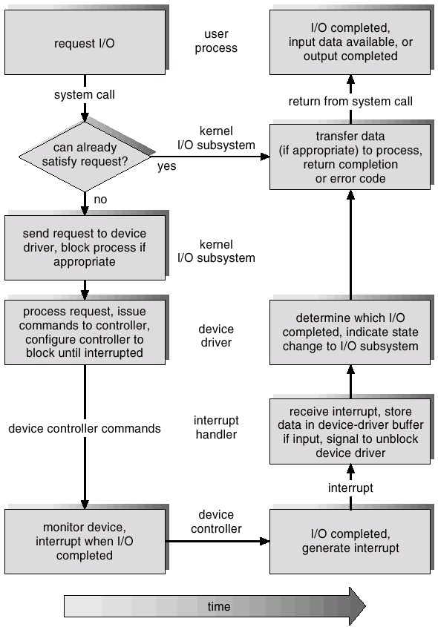
Life Cycle of An I/O Request

Slide 26
STREAMS
STREAM – a full-duplex communication channel between a user-level process and a device
A STREAM consists of:
- STREAM head interfaces with the user process
- driver end interfaces with the device
- zero or more STREAM modules between them.
Each module contains a read queue and a write queue
Message passing is used to communicate between queues

Slide 27
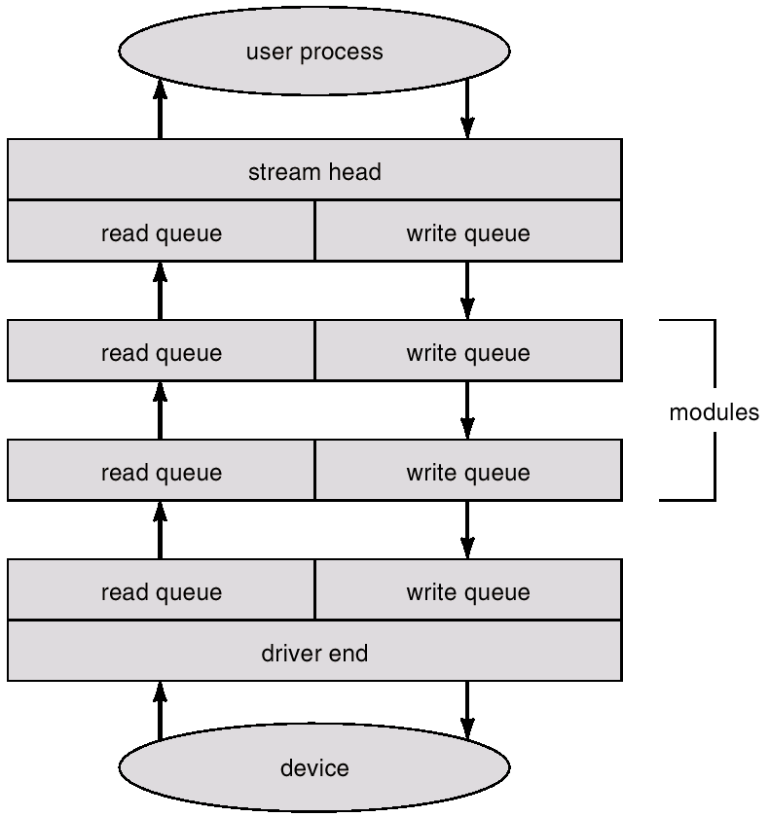
The STREAMS Structure

Slide 28
Performance
I/O a major factor in system performance:
  Demands CPU to execute device driver, kernel I/O code
  Context switches due to interrupts
  Data copying
  Network traffic especially stressful

Slide 29
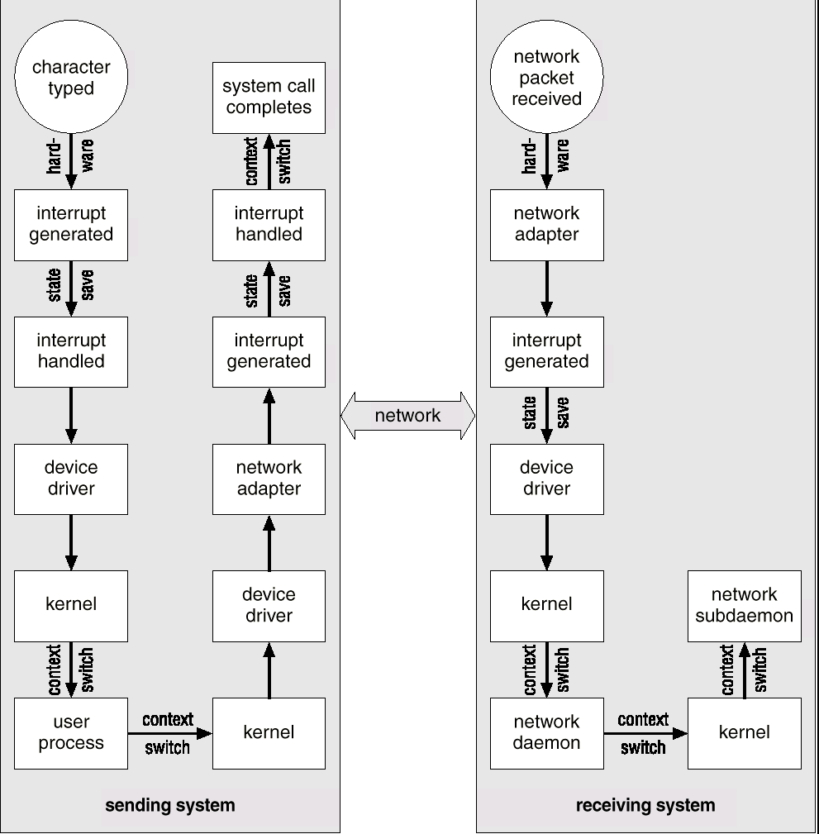
Intercomputer Communications

Slide 30
Improving Performance
Reduce number of context switches
Reduce data copying
Reduce interrupts by using large transfers, smart controllers, polling
Use DMA
Balance CPU, memory, bus, and I/O performance for highest throughput

Slide 31
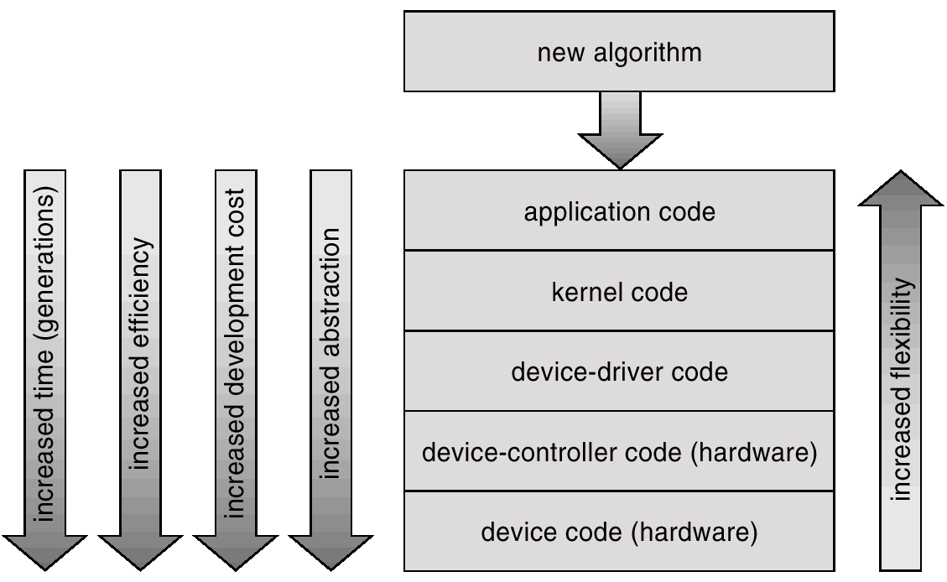
Device-Functionality Progression

